Slide 1
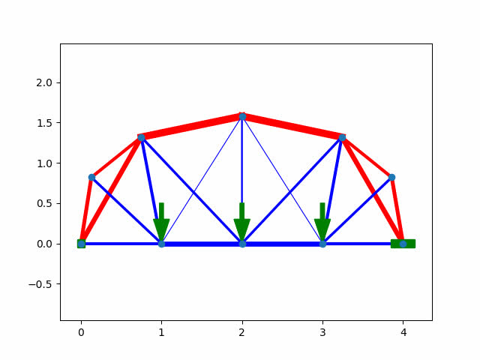
STRUCTURE OPTIMIZATION
Group 35:
Presented By:
Kavan Vavadiya [210100166]
Kush Patil [21d100016]
Darshan Makwana [21d100003]
Sanika Wagh [21d100018]
Under Guidance:
Prof. Avinash Bhardwaj
TA : Amritansh

Slide 2

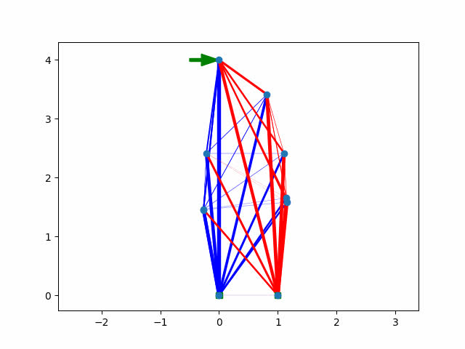
Motivation
Efficiency Improvement:
1
Optimized structures often require less material while maintaining or enhancing performance. This efficiency translates to cost savings in material usage and construction time.
Safety Enhancement:
2
Structural optimization ensures that buildings and infrastructure can withstand various loads and environmental conditions, guaranteeing the safety of occupants and users. This focus on safety is paramount for instilling confidence in the reliability of the structures.
Resource Conservation:
3
By conserving natural resources and reducing environmental impact, optimization contributes to sustainability. This dual benefit of economic and environmental stewardship aligns with modern green building practices and regulatory standards, appealing to both clients and stakeholders.

Slide 3

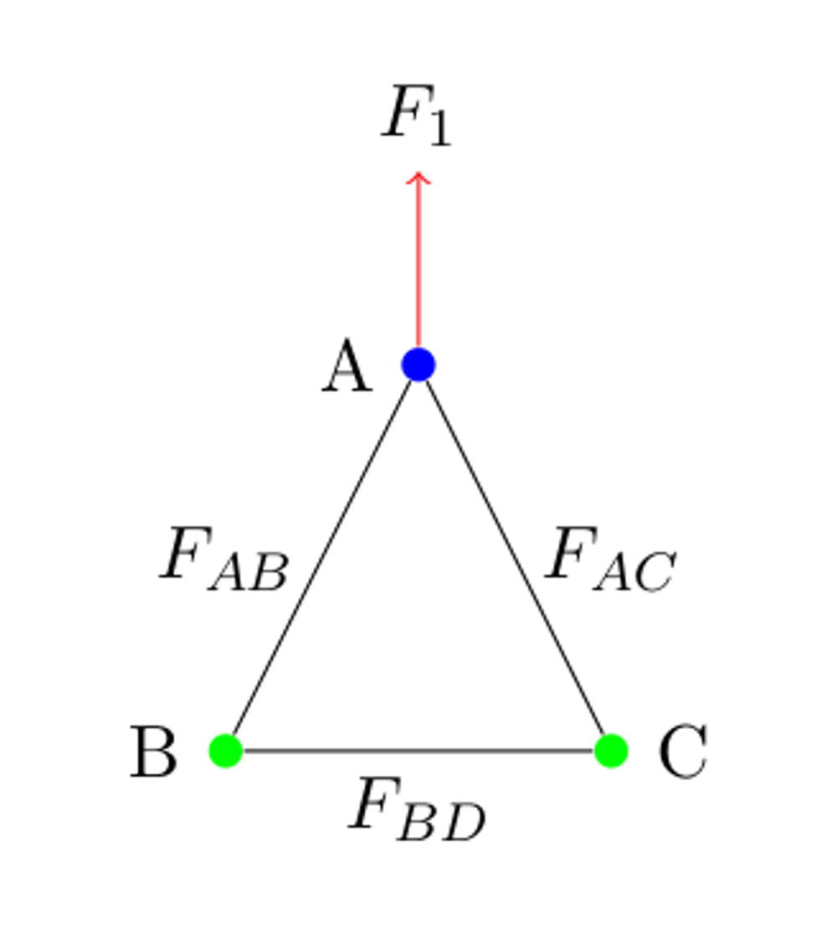
Project Overview
We define a structure as a set of N nodes and M member (links), a link is connected
between 2 nodes, it can only transmit forces along the direction of the link.
We consider upward and rightward forces to be positive and negative otherwise,
all angles to be taken from the horizontal, and compression forces to be positive
and tension forces negative. We assume that fixed(anchors) joints can exert arbitrarily
large forces on the truss.
.
Given a truss and the various forces acting on it we want to find the
optimal arrangement that can minimize the overall stress/strain/forces of the structure
Group 35

Slide 4
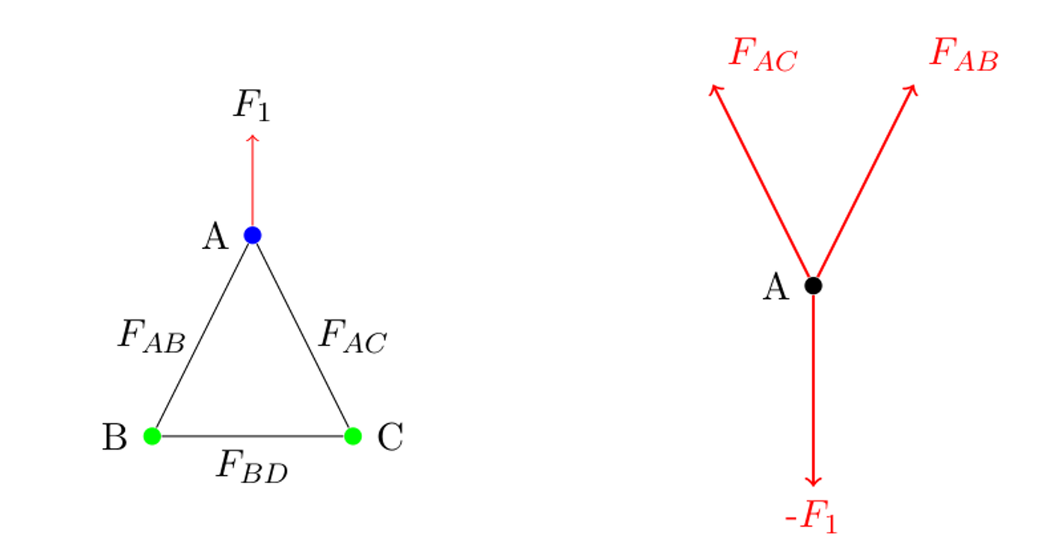
Structural Optimization Algorithm
Group 35

Slide 5
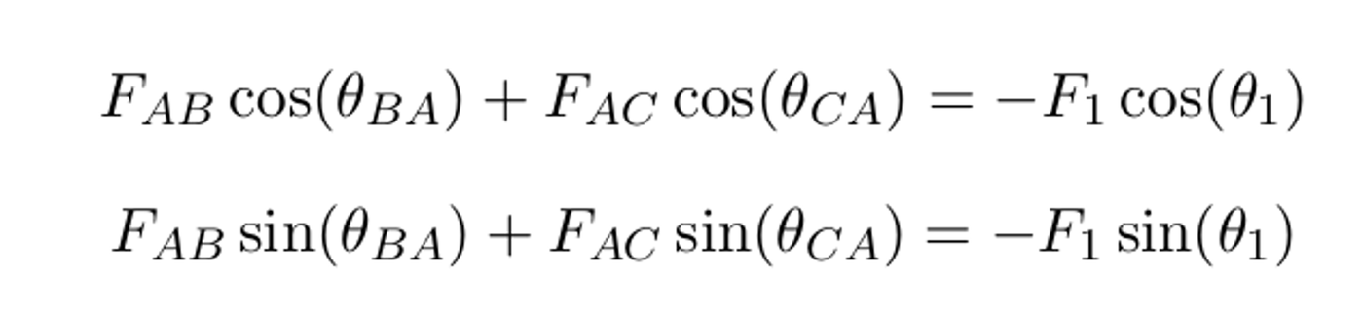
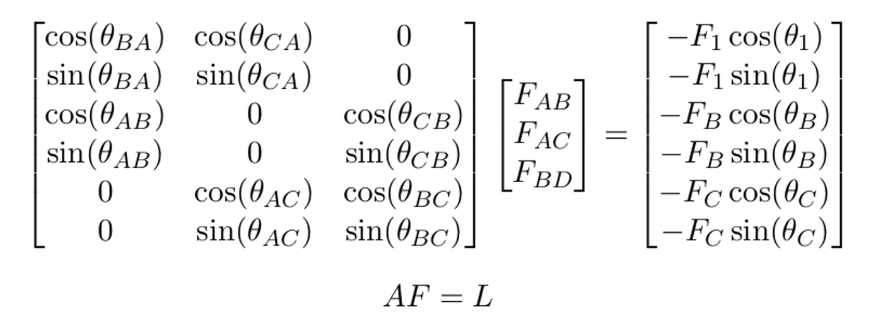
Applying the newton's laws of motion
With a slight reorganization the above equations can be written in matrix form as
Group 35

Slide 6
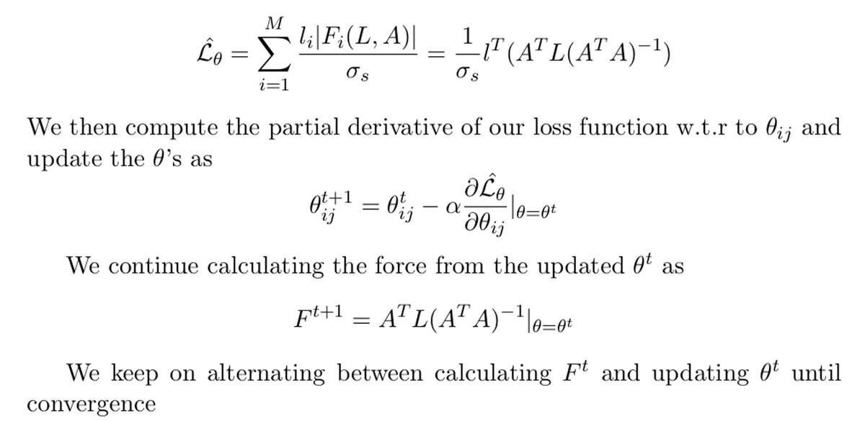
Here A is a 2N X M matrix dependent only on the directions of the links, F is column vector of size M representing the forces in the links and L is load vector of size 2N reprsenting the loads and joints at the nodes
Now we define the loss function as sum of strains in all the links
Group 35

Slide 7
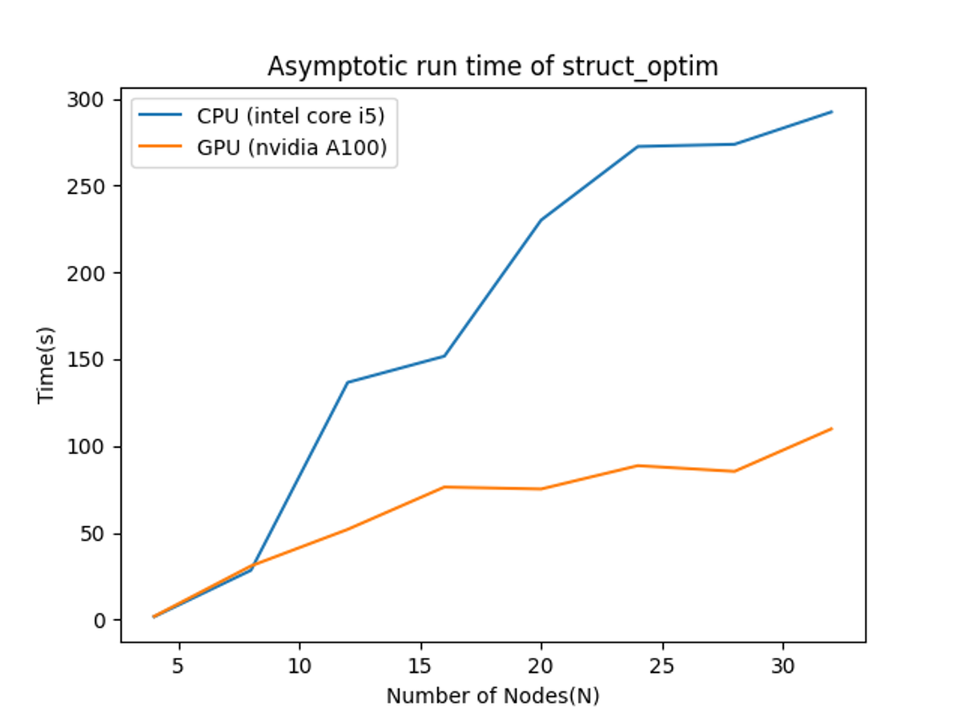
Benchmarks
Our algorithm shows a linear time complexity with respect to the number of nodes and much lower constant while utilizing the efficient matrix multiplication of GPU
Group 35

Slide 8
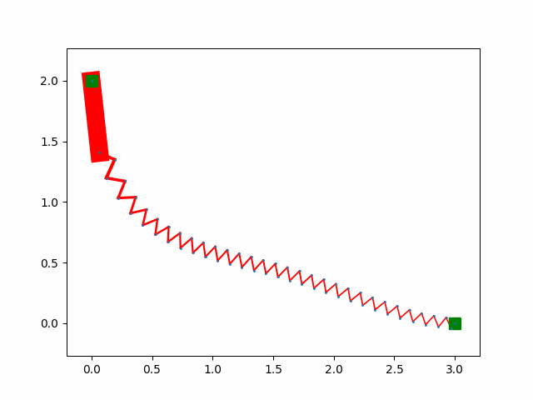
Experiments
Branchistochrone Problem:
The branchistochrone problem is the problem of finding a curve of shortest descent between two points, we assign a cost to each link as the total time it takes for a particle to travel it
Group 35

Slide 9
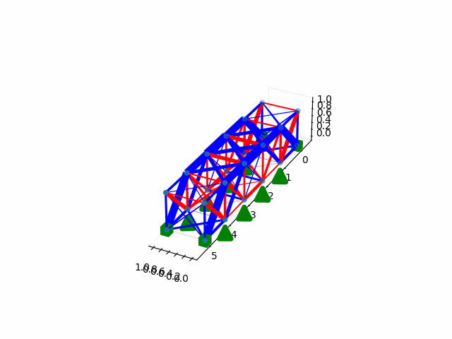
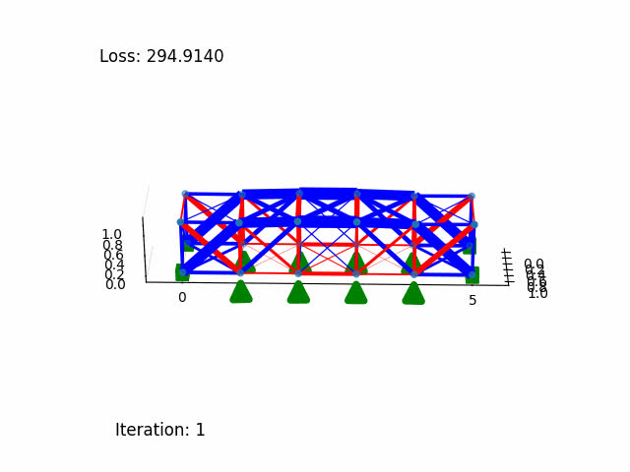
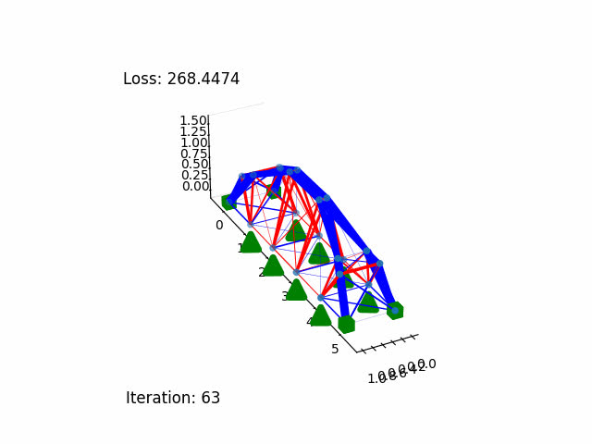
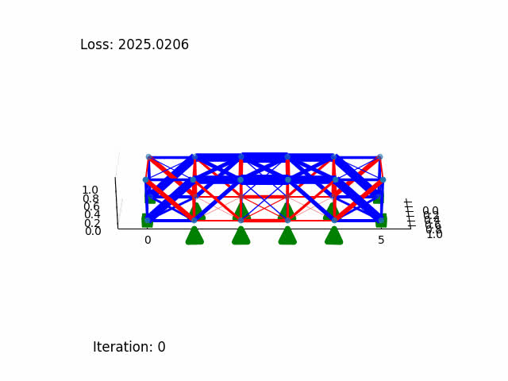
Experiments
Ablation Studies for Bridge
Initial Bridge | Minimizing Force | Minimizing Strain | Minimizing Strain Energy
Group 35

Slide 10
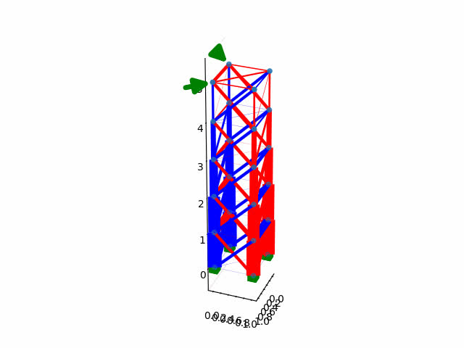
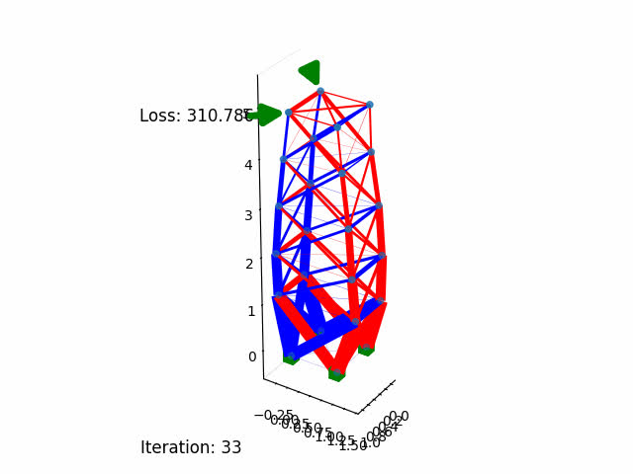
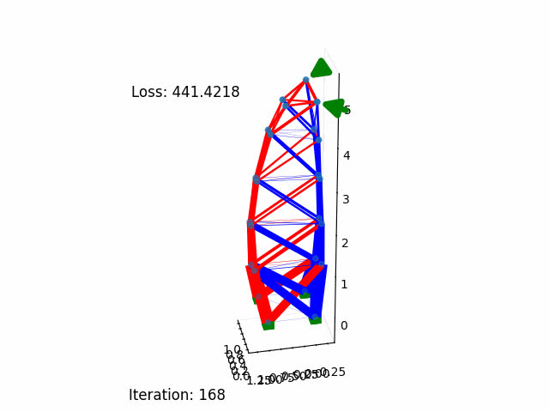
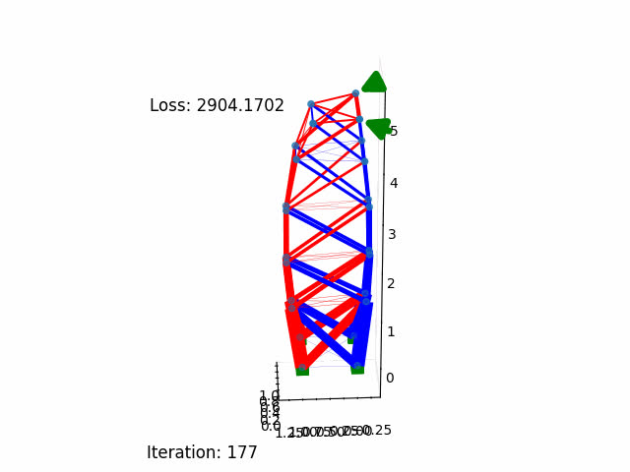
Experiments
Ablation Studies for Tower
Initial Bridge | Minimizing Force | Minimizing Strain | Minimizing Strain Energy
Group 35

Slide 11
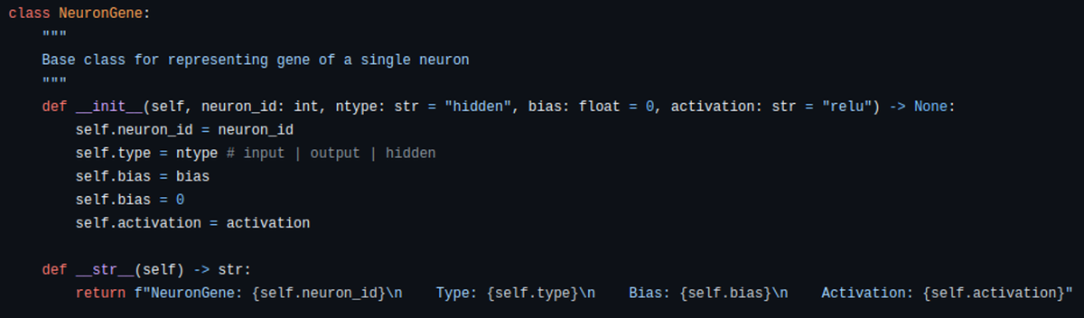
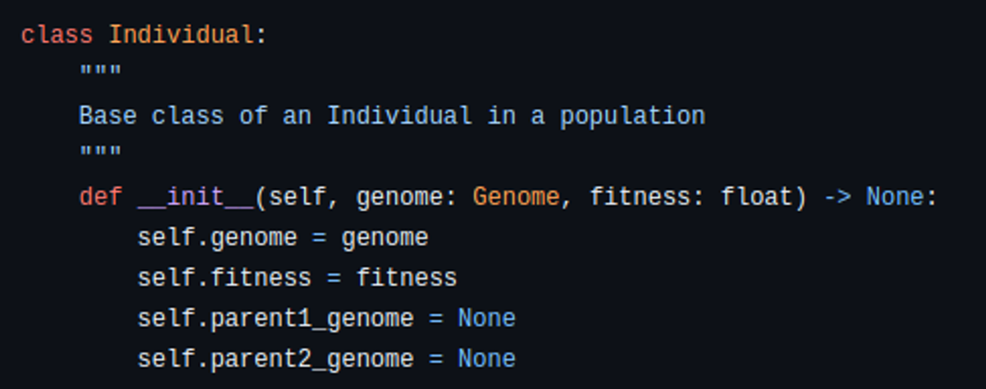
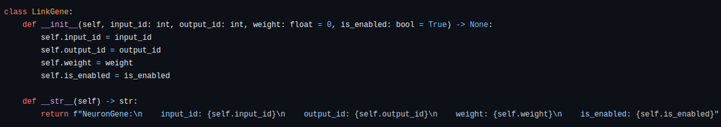
Neuro Evolution
Population Initialization:
NEAT starts with a population of minimal neural networks with no hidden layers, where each network represents a potential solution.
Group 35

Slide 12
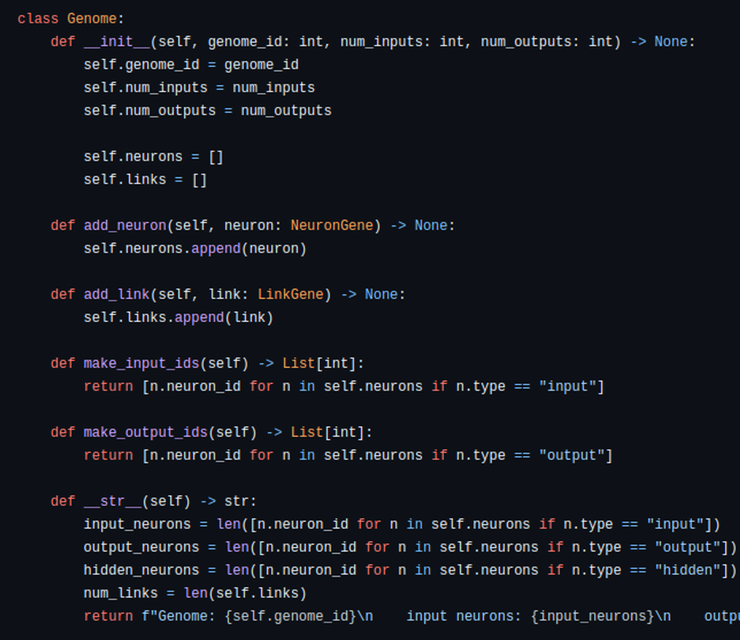
Neuro Evolution
Population Initialization:
Group 35

Slide 13
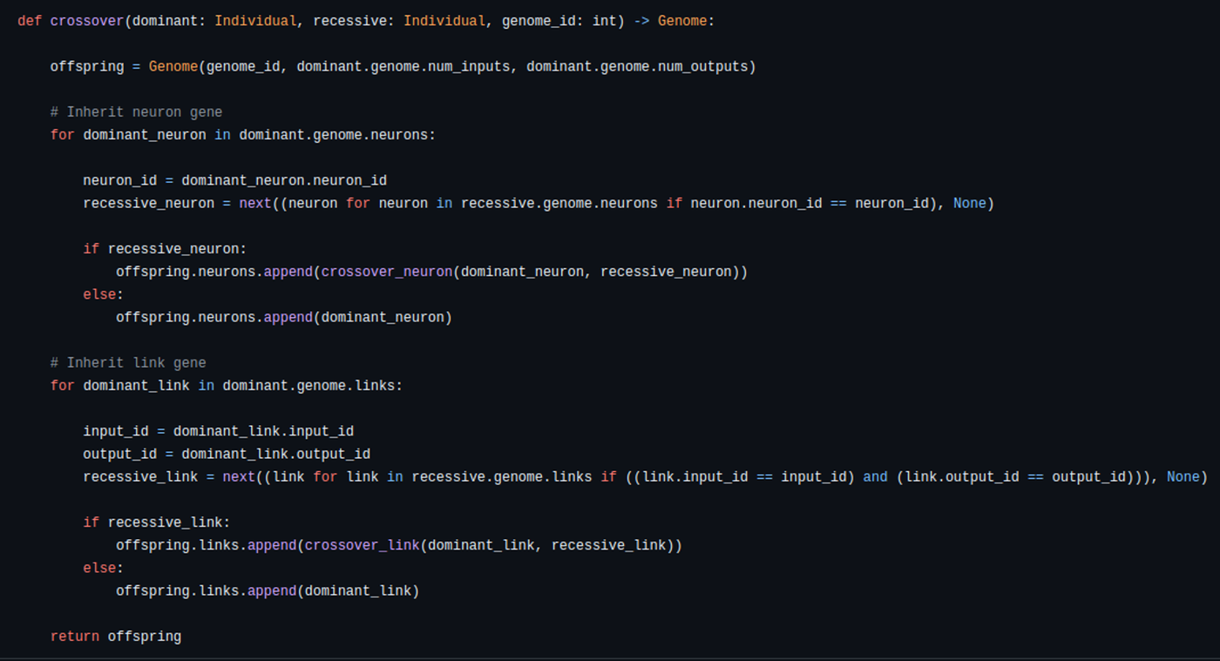
Neuro Evolution
Mutation and Crossover:
Genetic algorithms are used to create new generations by mutating the topology and weights of existing networks, as well as combining parts of two parent networks through crossover
Group 35

Slide 14
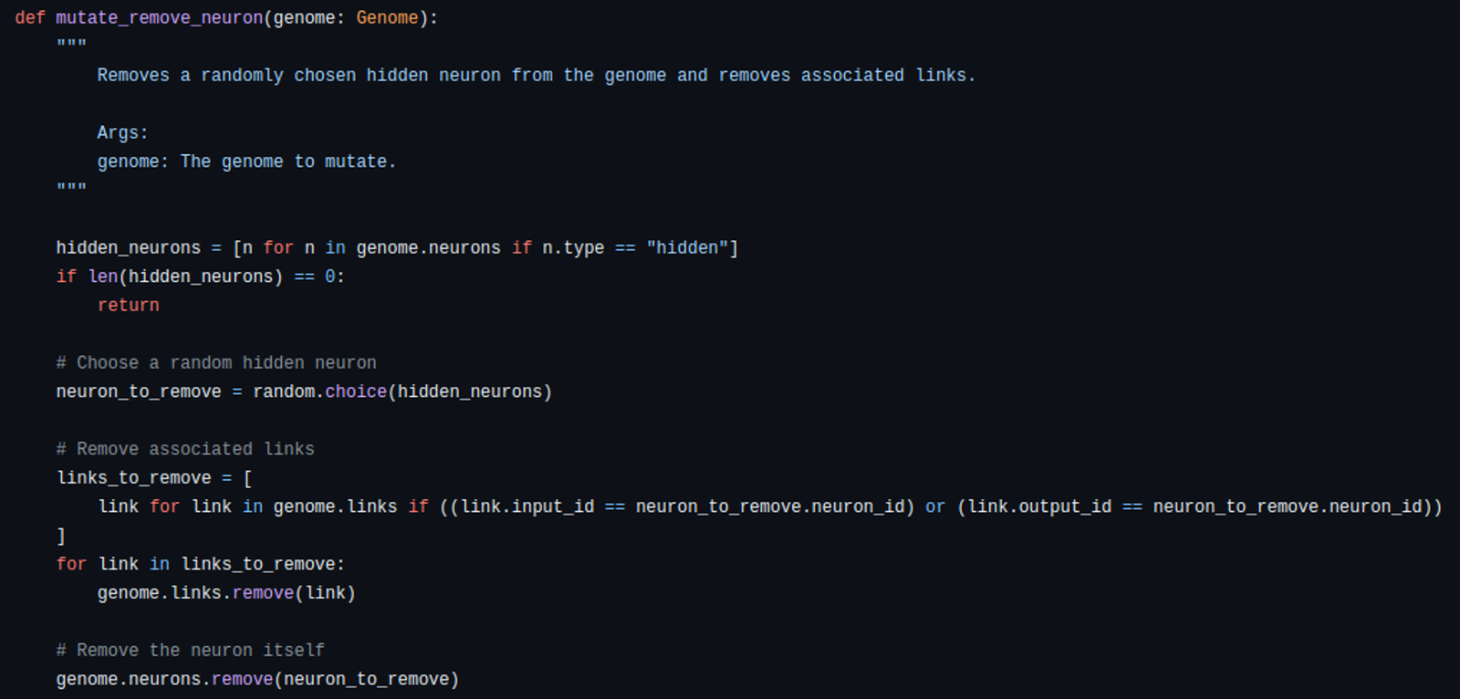
Neuro Evolution
Mutation and Crossover:
Group 35

Slide 15
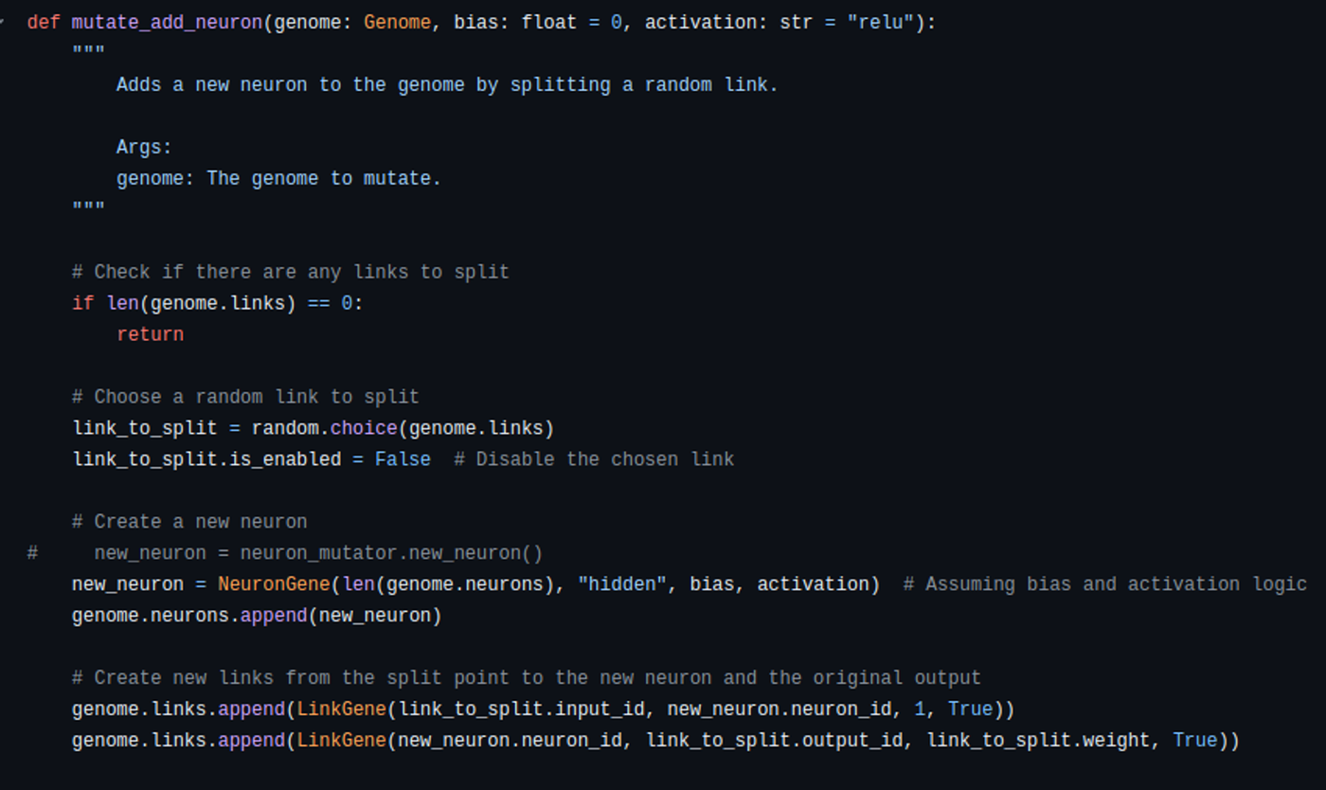
Neuro Evolution
Mutation and Crossover:
Group 35

Slide 16
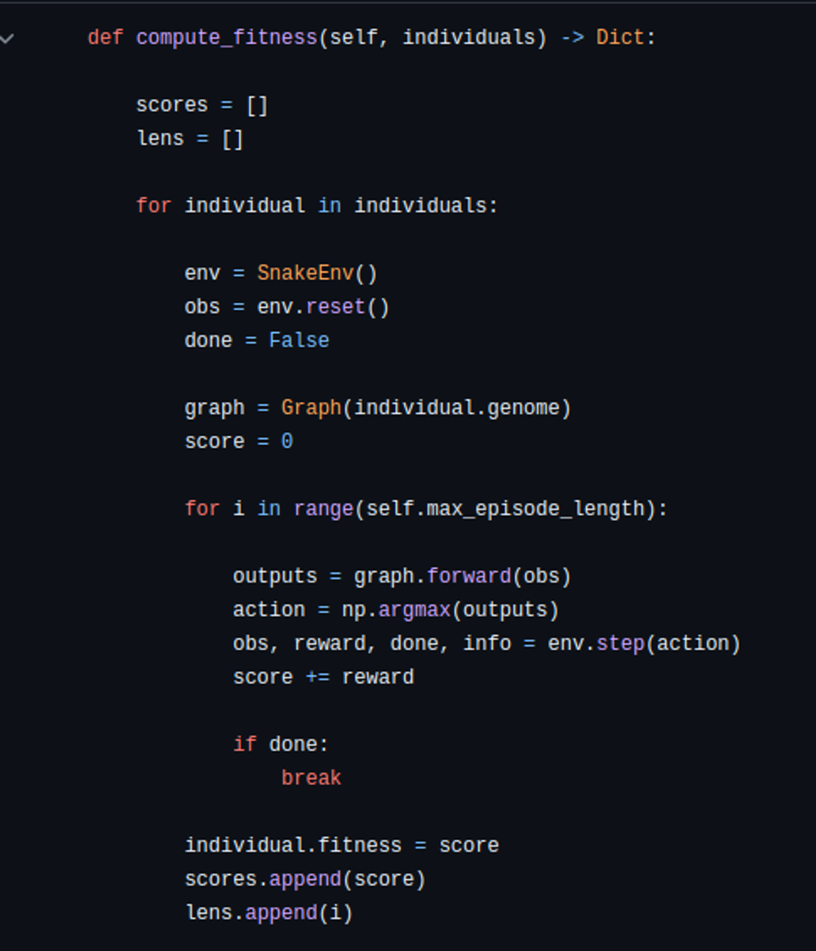
Neuro Evolution
Fitness Evaluation:
Each network is evaluated based on a fitness function specific to the problem, and the fittest networks are selected for reproduction.
Group 35

Slide 17
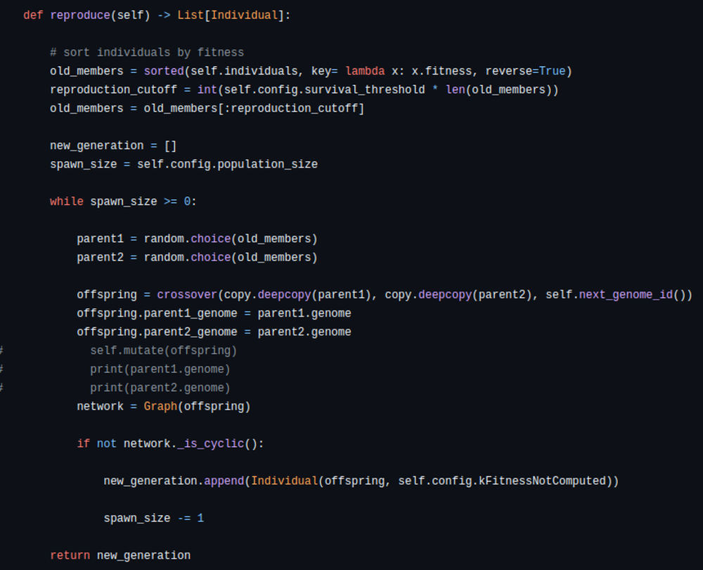
Neuro Evolution
Reproduction:
After evaluting the fitness of each individual only the best individuals are selected and are reproduced
Group 35

Slide 18
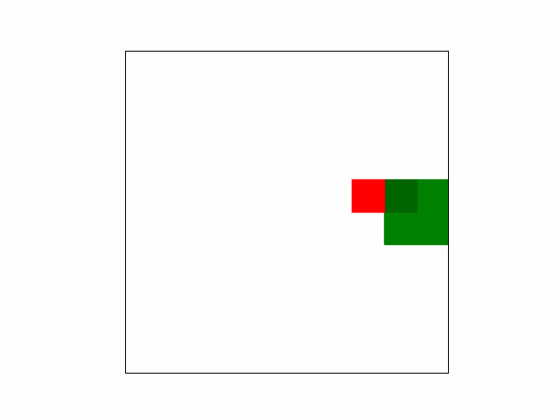
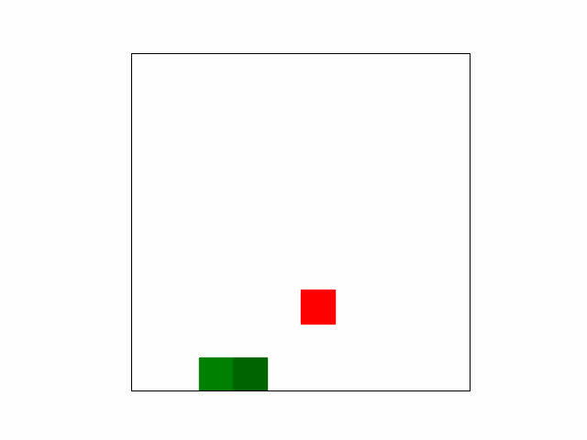
Neuro Evolution
Group 35

Slide 19
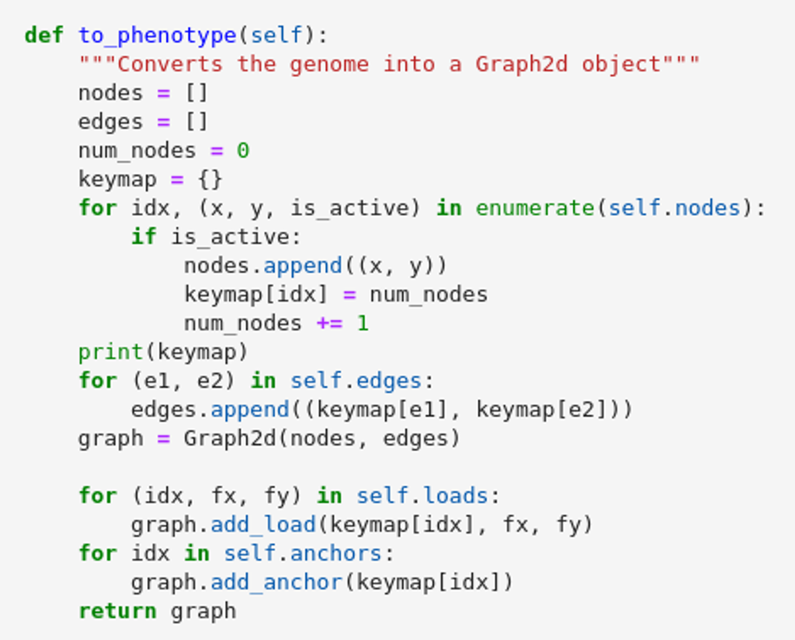
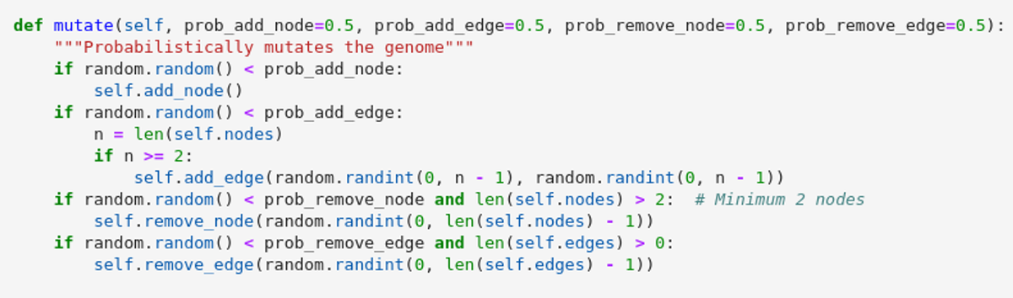
Neuro Evolution with Structural Optimization
Group 35

Slide 20
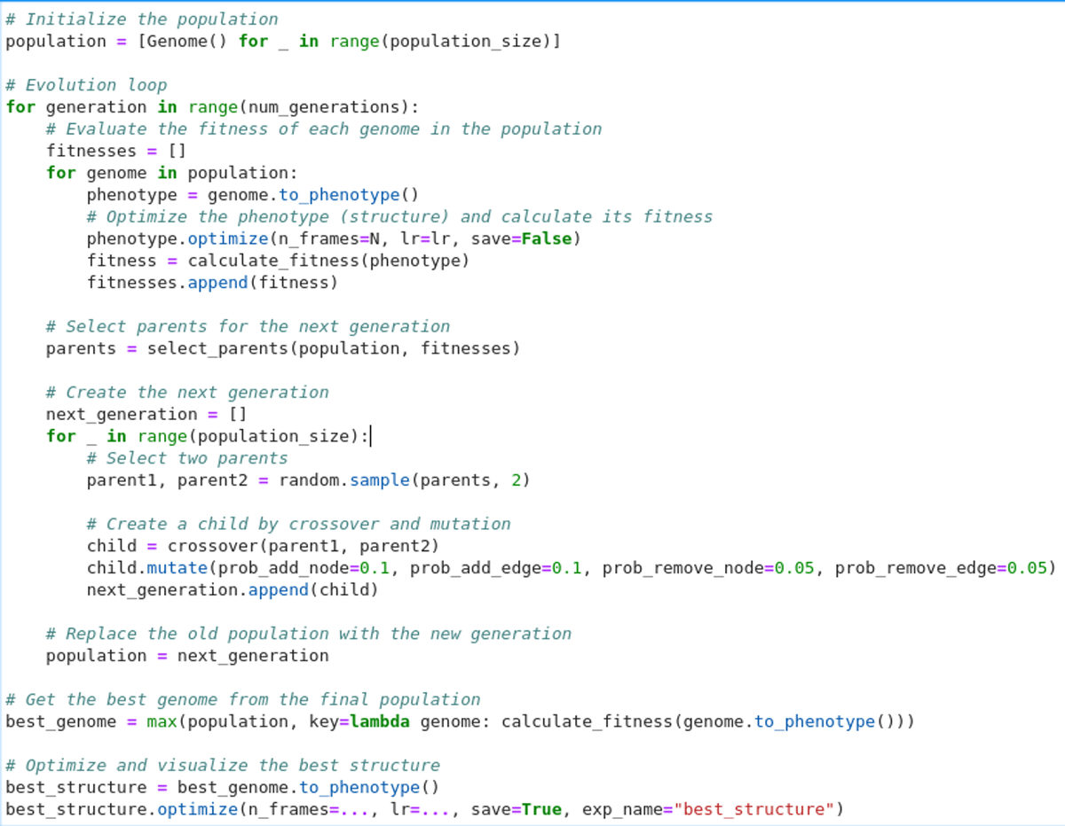
Neuro Evolution with Structural Optimization
Group 35

Slide 21
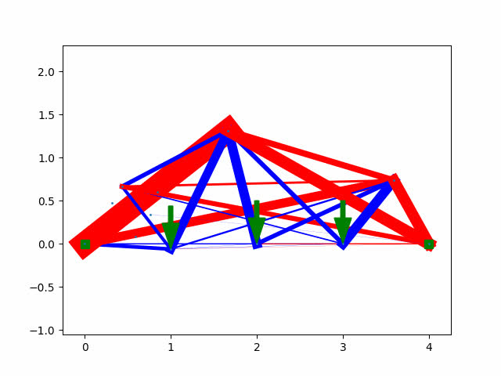
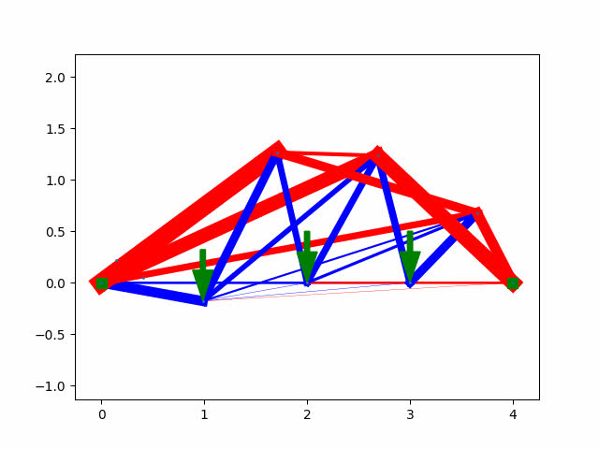
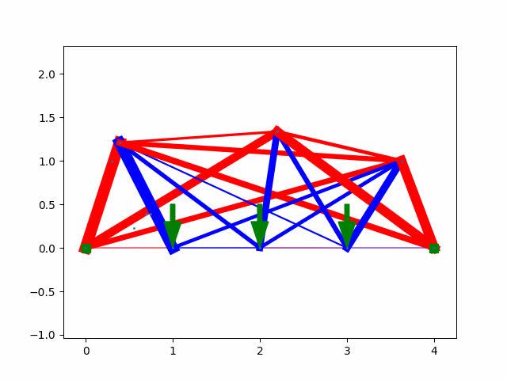
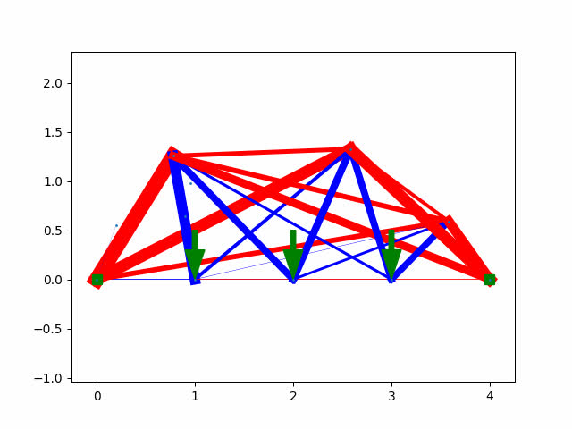
Results of Neuro Evolution
Evolution of Topologies
Generation 10 | Generation 20 | Generation 30 | Generation 40
Group 35

Slide 22
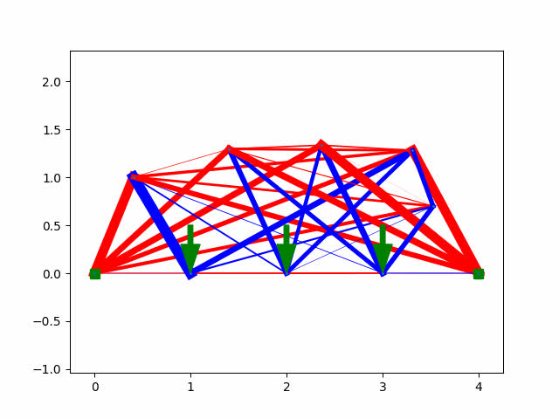
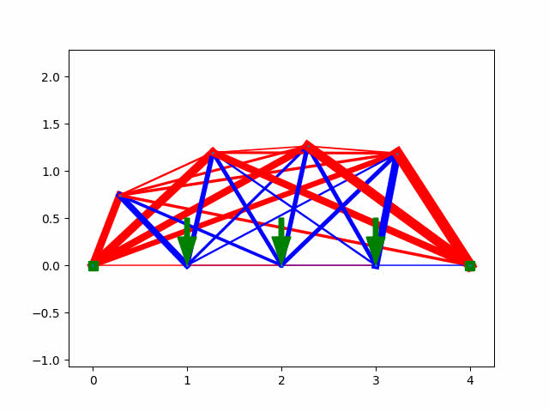
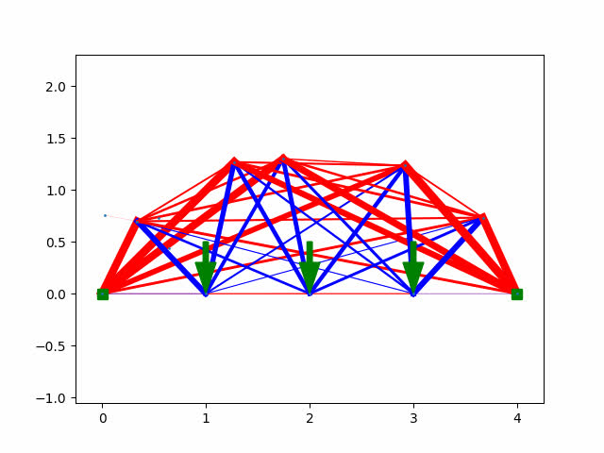
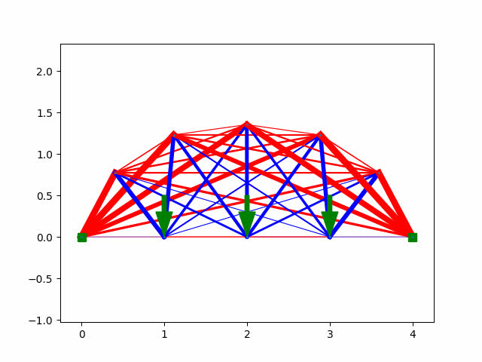
Results of Neuro Evolution
Evolution of Topologies
Population 50 | Population 60 | Population 70 | Population 80
Group 35
Total Simulation Time: 41 Hours

Slide 23
Future Work
We can convert the problem of the finding the most optimal structure into an equivalent seq2seq prediction problem and leverage the attention mechanisms of SOTA transformer models
We can also work on apply Low Rank Adaption of Matrices on the matrix A to further reduce the run time of struct optim
Group 35

Slide 24
Bibliography
Github Code :
https://github.com/darshanmakwana412/structure_optimization
https://github.com/darshanmakwana412/nanoNEAT
https://ieeexplore.ieee.org/document/6790655
https://nn.cs.utexas.edu/downloads/papers/stanley.ec02.pdf
Group 35

Slide 25
Contribution
Name | Contribution
Kavan Vavadiya
Kush Patil
Darshan Makwana
Sanika wagh
Group 35

Slide 26

Thank You

